Slide 1
Premiums & Downtown Zoning Evaluation

Slide 2
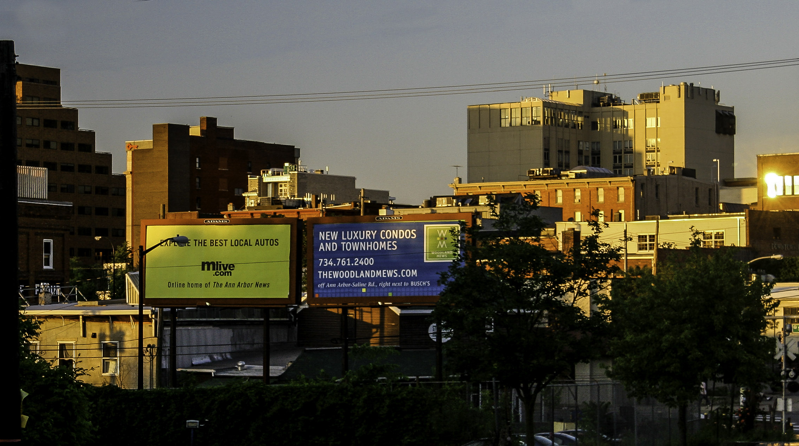
Team and project introduction
Photo from https://www.goodfreephotos.com/albums/united-states/michigan/ann-arbor/skyline-of-downtown-ann-arbor-michigan.jpg
Notes:
We have been hired by Community Services to complete an evaluation of the premiums and downtown zoning recommendations for the City. We anticipate meeting with you several times of the course of 2023 to develop options for downtown zoning, report stakeholder feedback on those options, and develop ordinance amendments.
The purpose of this report is to deliver our findings after a review and analysis of the outcomes of City of Ann Arbor’s Downtown Zoning, with a specific focus on premiums. This report is the first step in a longer process to determine if implementation of the City’s Downtown premiums and the resulting development is consistent with the City’s Vision and to explore whether and how changes to the Downtown Zoning should be made.

Slide 3
Agenda
Current Premiums
Timeline
Premium Use
City Plans & Policies
Market Data
Other Communities
Interviews
Discussion

Slide 4
Current Premiums
Affordable Residential Unit, in D1 and D2 districts only
3 tiers of increased % depending on percentage of affordable housing dwelling units provided
Green Building
50% with LEED Silver
150% with LEED Gold,
250% with LEED Platinum
Historic Preservation
50% with preservation of historic resource
Pedestrian Amenity, in C1A C1A/R and D1 districts only
10 sq. ft. per square foot of pedestrian amenity to maximum 8,000 square feet
Inner Arcade
Plaza
Public Parking, in D1 district only
Up to 200% with parking available to general public

Slide 5
Far / Height Comparison
District | Allowable (by-right) FAR | Bonus/premium FAR Maximum | Maximum Height
D1 | 400% | 900% | 180 feet
D2 | 200% | 400% | 60 feet
TC-1 | None | None | Up to 300 feet
C1 | 200% | NA | None
C1A / R | 300% | NA | None
R4E | NA (580 sq/ft lot area per dwelling unit) | NA | None

Slide 6
What we Reviewed
City Plans & Policies
Projects in the Downtown
Market Data
Best Practices in Similar Communities
Interviews

Slide 7
What we Found
Downtown Zoning Current Plans & Policies
Affordable Housing Premium not Used Often
Market Still in Flux
Other Downtowns Use Incentives
Premiums Implement City’s Vision & Goals

Slide 8
Timeline
1966
Pedestrian Premium
1994
Residential Premium
2009
Affordable Housing, Green Building, Public Parking & Historic Preservation
Premiums
2019
Residential & Affordable Housing
Premiums
Combined
1988
Definitions Changed
2006
Clarifications
2017
Building Design Standards

Slide 9
Timeline
2009
Affordable Housing, Green Building, Public Parking & Historic Preservation
Premiums
2019
Residential & Affordable Housing
Premiums
Combined
2017
Building Design Standards
2006
Clarifications

Slide 10
Timeline
2017
Building Design Standards
2022
Downtown Residential Task Force goal achieved
2006
Clarifications
2009
Affordable Housing, Green Building, Public Parking & Historic Preservation
Premiums
2019
Residential & Affordable Housing
Premiums
Combined
2004
Downtown Residential Task Force goal of 1,000 new housing units downtown by 2015
Data Source: ESRI Market Analyst using D1 & D2 Zoning Districts
Notes:
It seemed very successful, and gave confidence that could switch the ask to require affordable housing with the residential premium

Slide 11
Premium use
Notes:
Note that not everything is in the Downtown is eligible for premiums (historic district or floodplain not eligible).

Slide 12
Premium use
* Please note that some projects applied multiple premium options

Slide 13
City plans & policies
Notes:
A2 Zero plan not adopted through the comprehensive planning process. Not in the collection of 8 plans that make up the comprehensive plan of Ann Arbor.

Slide 14
Market data
High vacancy office rate
Downtown mix – higher percentage of office
Market still in flux after pandemic
More residential desirable downtown
Current policies delivering low-rise, luxury residential downtown

Slide 15
Other downtowns

Slide 16
Interviews
Downtown Zoning Current Plans & Policies
Affordable Housing Premium Difficult to Implement
Market Still in Flux
Strong Demand for Student Housing Inflates Property Prices
Zoning Should Change

Slide 17
Discussion questions
What actions do you want to explore to amend the Downtown Zoning?
What additional data or research is needed?
What stakeholders should be consulted once a menu of possible options has been determined by you?

Slide 18
questions

