Slide 1
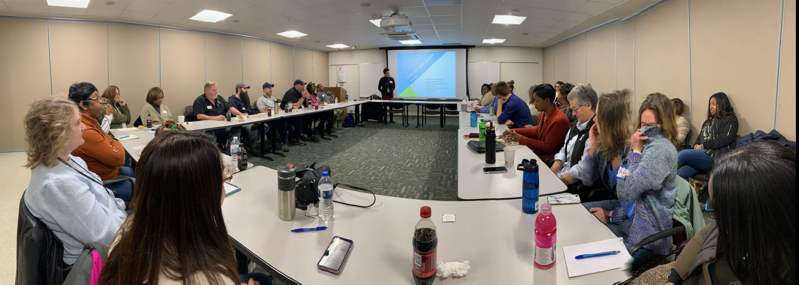
Ann Arbor Housing Commission

Slide 2
Group Questions
Introduce yourself – Name
2) What is something you would like to learn about affordable housing today?

Slide 3
WHAT IS AFFORDABLE HOUSING?
Housing that costs less than 30% of a household’s gross annual income. If housing costs (rent and utilities or mortgage, taxes & utilities) exceed 30%, it is considered a cost burden.
Newer Definition
Housing + Transportation if exceeds 45% of income then cost burden
Notes:
Acknowledge housing is needed in all income ranges, sizes and styles, condos, rental, owner, single family etc.
No difference between Affordable and Worforce - marketing not definition
EITHER Income or age restricted or market rate
Only other clearly defined term is Permanent supportive housing
Income restriction by upper level of income range and inclusive of everything below
Rental or owner but primarily talking about rental today because people with low incomes primarily renters therefore also rent restriction
Miller Manor & Cranbrook Towers 100% low-income due to funding source requirements. Depending on financing, can do mixed-income with or without market rate housing.
Affordable vs. Workforce, Senior 55+, Mixed-income, Mixed Use, Permanent Supportive Housing
In the study – we identified need for 2,711 in A2 up to 60% AMI
If we use the same study to look at the need for units from 60-100% AMI, it would be an additional 3,748

Slide 4
Ann Arbor Housing Commission
01
Affordable Housing Properties
20 properties in the City of Ann Arbor
564 apartments
02
Voucher Programs – Washtenaw & Monroe Counties
2,218 Vouchers
03
Family Self-Sufficiency & Homeownership Programs
99 – 130 FSS participants
13 Homeowners
04
Finance and Administration
$50 Million Annual Budget
46 Staff
Open House West Arbor – Ribbon Running

Slide 5
Affordable Housing
AAHC owner & property manager
84 Studios
281 1-bdr
80 2-bdr
76 3-bdr
29 4-bdr
14 5-bdr
Income Restrictions 30%, 50%, 60% & 80% Area Median Income Eligibility
80% of units have Project-Based Rent Subsidies
Tenants pay 30% of Income as rent
Hikone gardening program

Slide 6
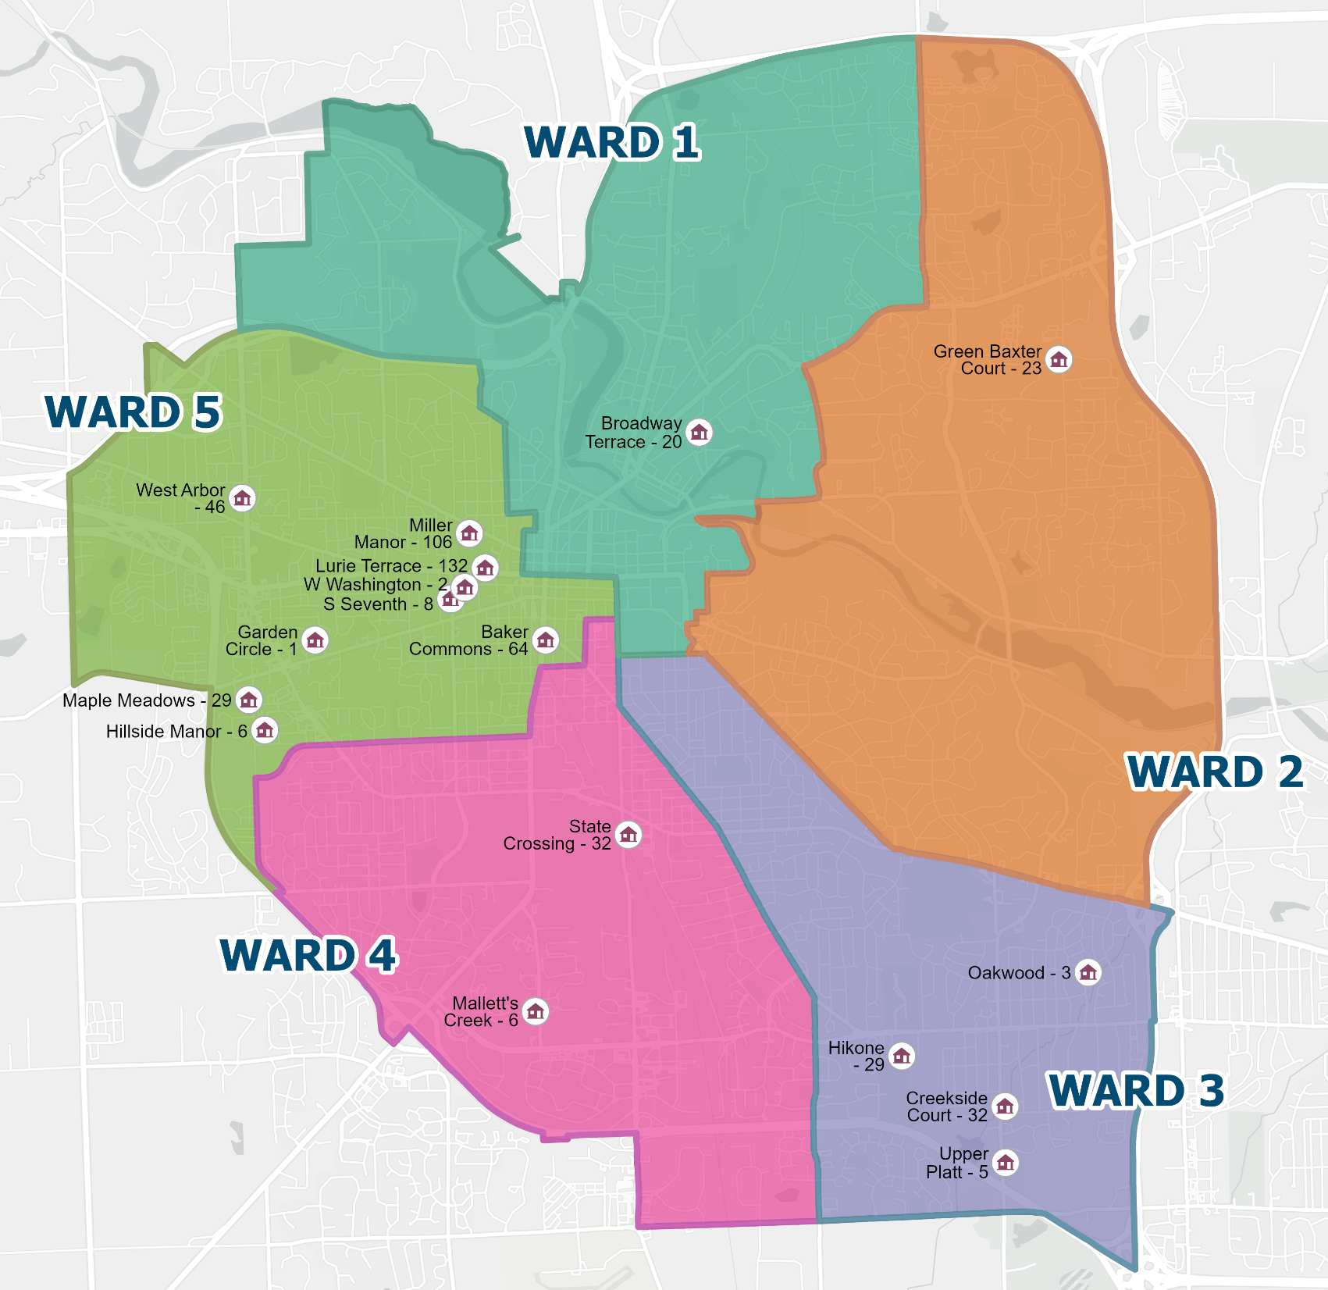
AAHC Resident Income

Slide 7
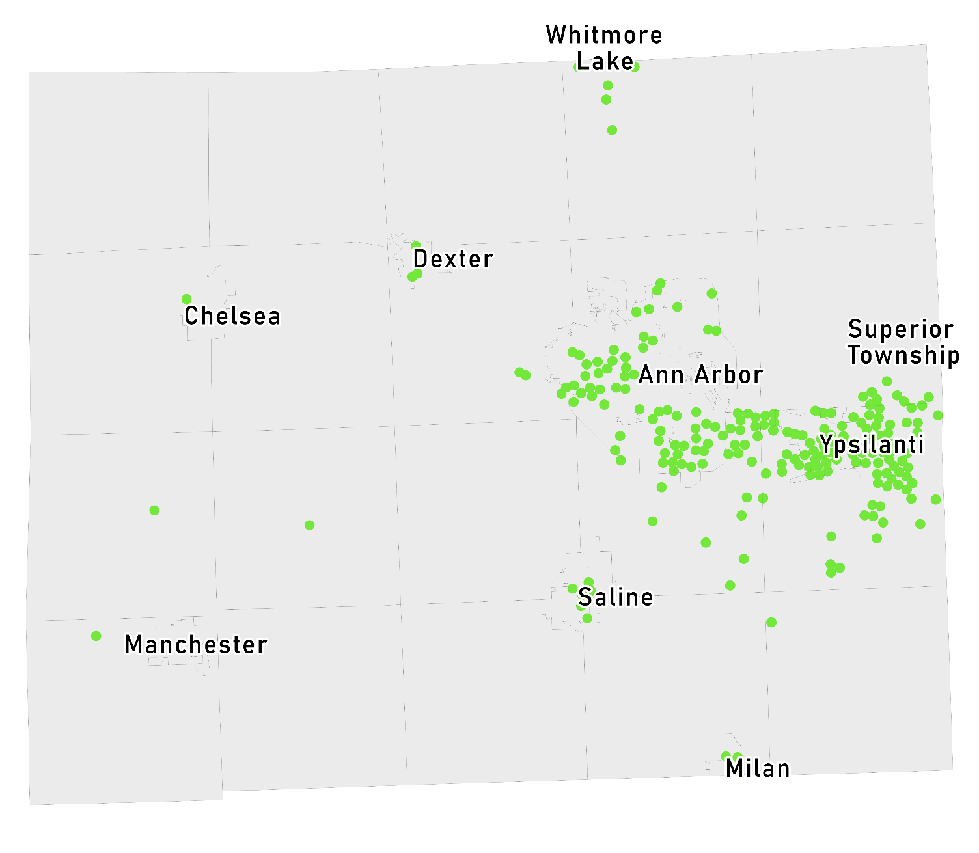
Voucher Programs
AAHC Administers
1,249 Housing Choice Vouchers
237 Veterans Affairs Supportive Housing (VASH) for Homeless Veterans
351 Non-Elderly Disabled Vouchers
32 Family Unification Vouchers
29 Emergency Housing Vouchers
336 RAD Project-Based Vouchers on AAHC properties
Rent Subsidy Private Sector
30% of Income as Rent
50% Area Median Income Eligibility
Distribution of All AAHC Vouchers in Washtenaw County

Slide 8
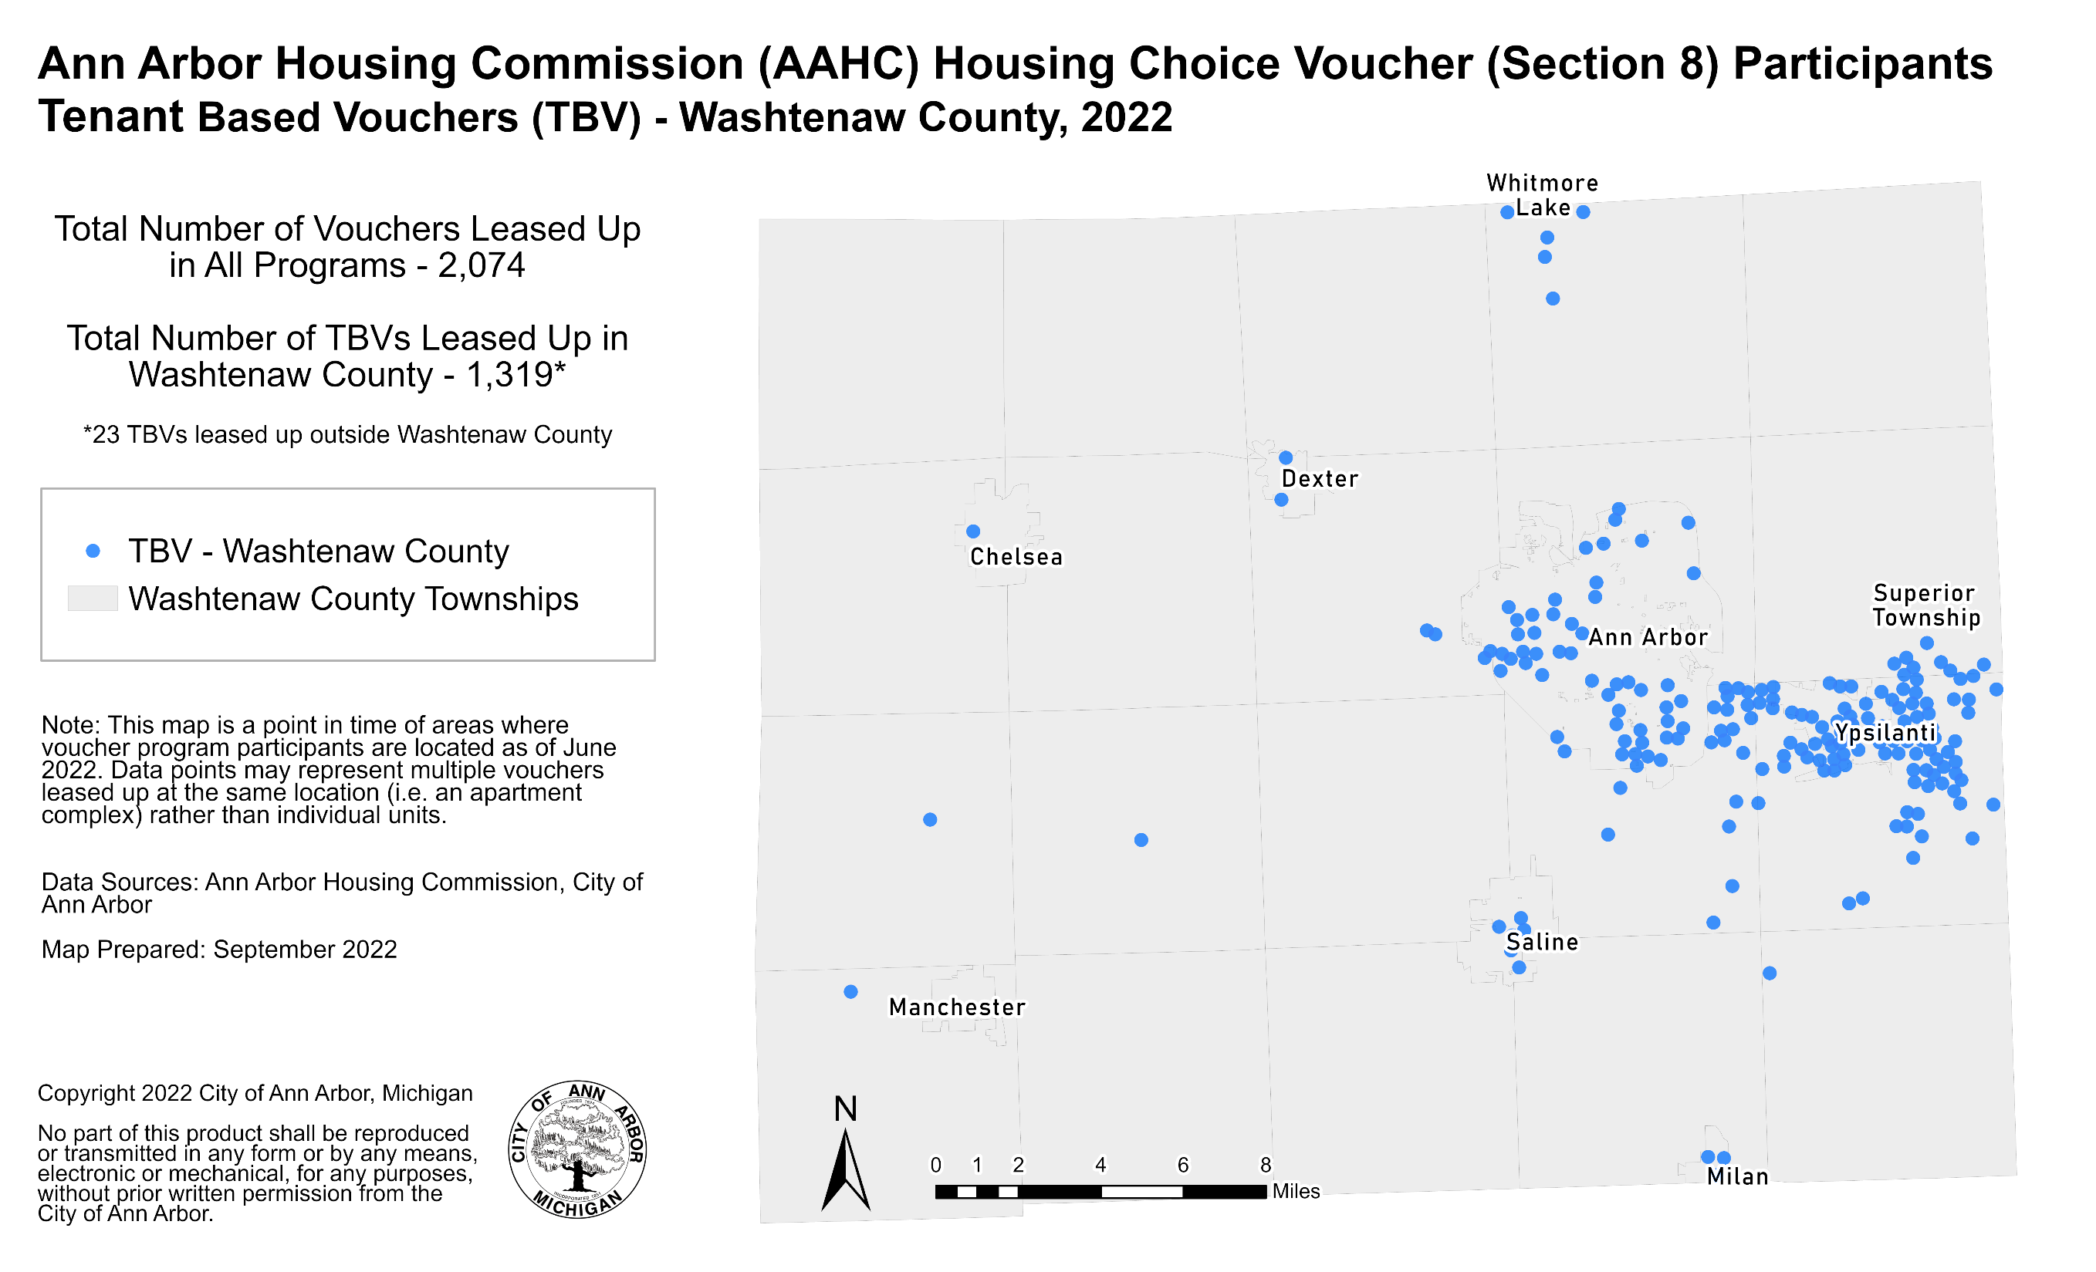

Slide 9
Community Partners
Mental Health and Supportive Services
Client-centered Case Management, Mental Health, Community Building, Crisis Services, Financial Literacy, Jobs, Youth Programs, Support Groups, Eviction Prevention, Quality of Life Services, Resident Council, Art Therapy, Medical Services
Peace Neighborhood Center
Ozone House
Community Mental Health
SOS
Food Gatherers
Michigan Works
Community Action Network
Avalon
Housing
PACE
VA
University of Michigan School of Pharmacy
Packard Community Clinic
Resident Art Room at Miller
www.a2gov.org

Slide 10
How are low-income residents impacted by the City of Ann Arbor’s Housing Market?

Slide 11
2024 Ann Arbor Area Median Income
Area Median Income | 1 Person | 2 Person | 3 Person | 4 Person | 5 Person
30% | $25,100 | $28,700 | $32,300 | $35,850 | $38,750
50% | $41,850 | $47,800 | $53,800 | $59,750 | $54,550
60% | $50,220 | $57,360 | $64,560 | $71,700 | $77,460
80% | $66,950 | $76,500 | $86,050 | $95,600 | $103,250
100% | $83,700 | $95,600 | $107,600 | $119,500 | $129,100
120% | $100,400 | $114,8000 | $129,200 | $143,400 | $155,000
Ann Arbor Primary Metropolitan Statistical Area includes all of Washtenaw County – Median Family Income = $119,500 USA = $77,397
HUD places the Area Median Income into the 100% AMI 4-person household slot, and all other incomes are a formula based off that number
Notes:
2021 $106,600

Slide 12
2024 Affordable Monthly Housing Costs Based on Spending 30% of Income
Area Median Income | 1 Person | 2 Person | 3 Person | 4 Person | 5 Person
30% | $628 | $718 | $808 | $896 | $969
50% | $1,046 | $1,195 | $1,345 | $1,494 | $1,614
60% | $1,256 | $1,434 | $1,614 | $1,793 | $1,937
80% | $1,674 | $1,913 | $2,151 | $2,390 | $2,581
100% | $2,093 | $2,390 | $2,690 | $2,988 | $3,228
120% | $2,510 | $2,870 | $3,230 | $3,585 | $3,875
MSHDA published Maximum rents for Low Income Housing Tax Credit Program
Notes:
MSHDA LIHTC

Slide 13
Federal Poverty Level
Family Size | 2024 Poverty Threshold Income
Individuals | $15,060
2 people | $20,040
3 people | $25,820
4 people | $31,200

Slide 14
Housing Units and Rent
*Affordable Units <= 60% AMI
Year
Median Rent
Total Housing Units
Year
Total Number of Housing Units
Average Rent
Notes:
TC
This graph shows all of the County's housing stock – both rental and owner-occupied – year over year from 2012 to 2021. During this 9-year span, the County gained an additional 10,226 housing units.
The small blue segment shows vacant housing units in the County, which in 2021 was only 8,827 units -- which represents only 6% of the total housing stock that year.
Median rent was $921 in 2012 and rose to $1,225 by 2021 – a 33% increase over a 9- year period.
The yellow line running horizontal toward the bottom of the graph shows the # of affordable rental units in the County from 2016 through 2021, pulling from the Affordable Housing Dashboard that was launched at OCED in 2015 to track progress against the goals set by the County's 2015 Housing Affordability and Economic Equity Analysis.
Affordable is defined here (and on the affordable housing dashboard) as income and rent restricted for households with incomes at or below 60% of Area Median Income.
The number of affordable units in Washtenaw has decreased by a net of 758 units; because while while we’ve had 233 new affordable units come online since 2015, during this same time span we have lost 991 units that have converted to market rate.
In 2021 – we had around 4,554 affordable units, which makes up just under 3% of the County’s total housing units.
Reference to Affordable Housing Dashboard: https://www.arcgis.com/apps/dashboards/bf43a42c68ec45539908236f6c63e35b

Slide 15
Fair Market Rents Washtenaw County
1-bdr FMR in FY 1983 – $372
1-bdr FMR in FY 2000 – $581
1-bdr FMR in FY 2024 – $1,234
Source: U.S. HUD.
Notes:
To mitigate rising costs, the U.S. Housing of Urban Development recently upped fair market rents by 10.3% in Michigan.
In comparison, fair market rents typically go up 4% every year.
No FMRs in 1984.

Slide 16
African American Population Washtenaw County 1960 Prior to Fair Housing and Civil Rights Laws
Notes:
This map is important in understanding the discussion and decisions made in the 1960’s related to forming the Ann Arbor Housing Commission and developing affordable housing.
The Black community in Ann Arbor was on the West Side, what is generally the 5th Ward. The dark orange area shows that the Black neighborhood was in and around what is now known as Kerrytown, and West toward Chapin St and North toward Summit. This area was previously an industrial/commercial area with slaughterhouses and other dirty industries in the 1800’s and early 1900’s. Jones School was the neighborhood school before it became Community High School. 4th & Ann Street was the Black business district. The Dunbar Community Center on 4th Ave was a central part of Black Social and Civic life.
If we blew this map out to show all of Washtenaw county it is light yellow everywhere else. Washtenaw County was highly racially segregated in 1960 and the County remains segregated by race and income. The 2015 Martin Prosperity’s Institute's 2015 report – Segregated City, The Geography of Economic Segregation in America’s Metros named Washtenaw County is currently the 8th most segregated county by income in the United States.

Slide 17
Notes:
2015 Washtenaw County was the 8th most segregated county by income in the United States according to the Martin Prosperity’s Institute's 2015 report – Segregated City, The Geography of Economic Segregation in America’s Metros. As Ann Arbor has gentrified, shift in where Black families and other people of color are living and where white families are living. White families tend to move to Western part of Washtenaw County and People of Color tend to move to Eastern part of the county
Washtenaw 74% white Black 13% amer indian/Alaskan .04% Asian 9% 2 or more races 3% Hispanic 5%
Michigan 80% white Black 14% amer indian/Alaskan 1% Asian 3% 2 or more races 2% Hispanic 5%
Washtenaw 15% poverty, Michigan 15% poverty
Poverty rate in Michigan
percent white 8% black 24% other 11% Hispanic 23%
number white 609,400 black 316,600 other 64,600 Hispanic 118,700
Census - % Black only population in city of Ann Arbor:
1980 – 9.3%
1990 – 8.9%
2000 – 8.8%
2010 – 7.7%
ACS 2016 – 7.3%
(not more that “two or more races” in effect starting in 2000.

Slide 18
Poverty by Census Tract
Qualified Census Tract: 50 percent of households with incomes below 60 percent of the Area Median Gross Income (AMGI) or have a poverty rate of 25 percent or more.
Source: 2023 HUD Office of Policy Development & Research, Qualified Census Tracts
Notes:
Qualified Census Tract: 50 percent of households with incomes below 60 percent of the Area Median Gross Income (AMGI) or have a poverty rate of 25 percent or more.

Slide 19
Ann Arbor 2020 Poverty by Age and Gender
Source: DATA USA, Ann Arbor, 2020

Slide 20
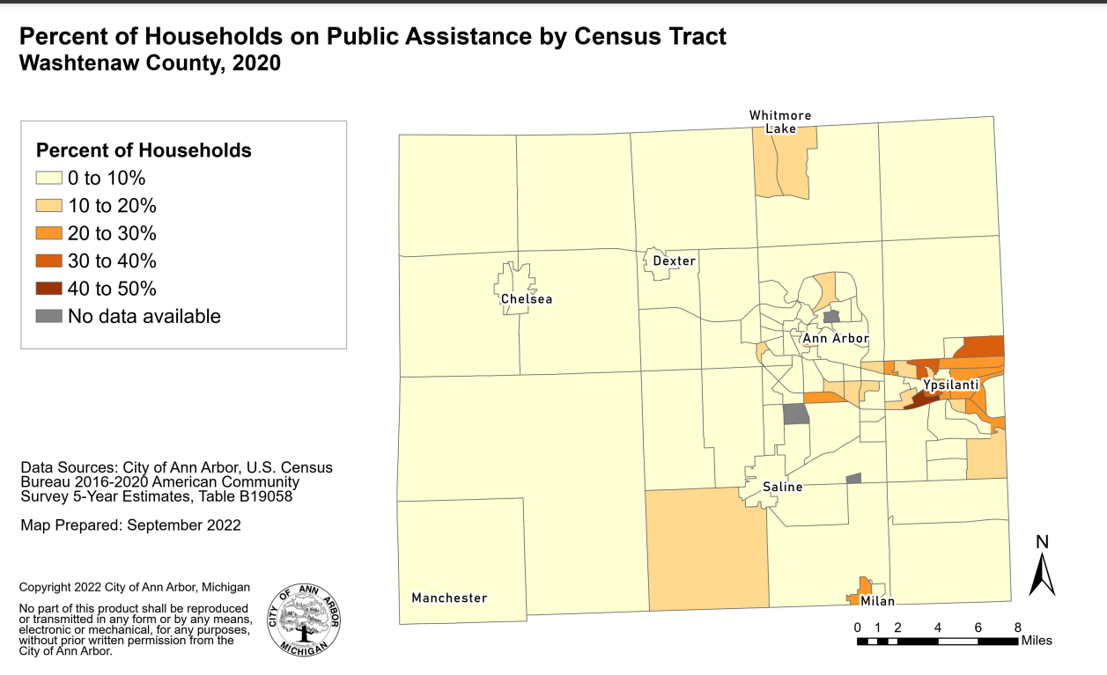
Notes:
Martin Prosperity’s Institute's 2015 report – Ann Arbor Metro Area is the 8th most Economiclly Segregated City
Monroe MI 2nd most economically desegregated city.

Slide 21
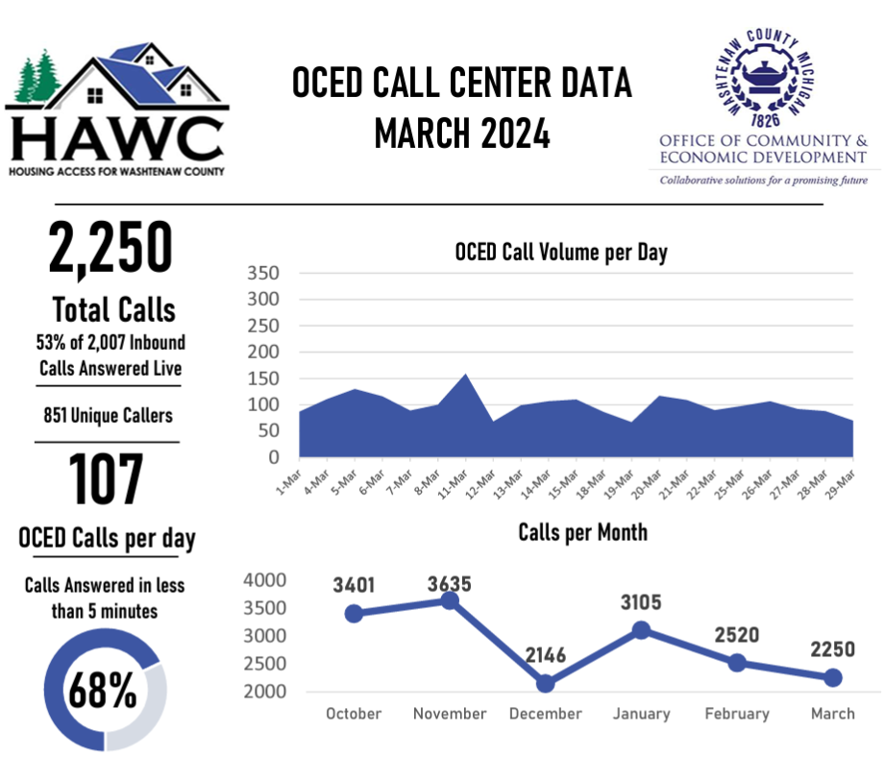
Notes:
24.3% Diversion
22.9% Intake/Assessment
21.4% CERA
17.1% non-housing need
11.5% case status

Slide 22
People Experiencing Homelessness In Washtenaw County
Dec 2021 – Dec 2022 in Continuum of Care System
Notes:
Family number includes each person in household. About 2500 by name households in 2021.

Slide 23
Major Area Employers
Company Name | Organization Type | # of Employees
University of Michigan | Public university and health care system | 34,300 – 34,399
St. Joseph Mercy Health Systems | Health care system | 5,800 – 5,899
General Motors Proving Grounds | OEM research | 5,500 – 5,599
VA Ann Arbor Healthcare System | Health care system | 2,800 – 2,899
Ann Arbor Public Schools | Public school district | 2,500 – 2,599
Toyota Technical Center | OEM research | 2,200 – 2,299
Faurecia Interior Systems | Automotive component manufacturer | 1,800 – 1,899
IHA Health Services Corporation | Multi-specialty physician group practice | 1,600 – 1,699
Eastern Michigan University | Public university | 1,300 – 1,399
Washtenaw County Government | County government | 1,300 – 1,399
Domino’s Pizza | Corporate headquarters | 1,000 – 1,099
Thomson Reuters | Software and information services for professionals | 1,000 – 1,099
Thai Summit America | Automotive component manufacturer | 800 – 899
City of Ann Arbor | City government | 700 – 799
Truck Hero Inc. | Automotive component manufacturer | 700 – 799
Grupo Antolin Interiors | Automotive component manufacturer | 700 – 799
Zingerman’s Community of Businesses | Food production | 700 – 799
IBM Watson Health | Data and information | 700 – 799
Terumo Cardiovascular Group | Medical device manufacturer | 700 – 799
Citizens Insurance Company of America | Property and casualty insurance | 700 – 799
Source: Ann Arbor SPARK (January 2022)

Slide 24
U of M Enrollment and Ann Arbor Population
U of M enrollment in 1999 – 37,846
U of M enrollment in 2018 - 46,716
U of M enrollment in 2023 -51,225
Sources: University of Michigan Office of the Registrar and Housing.
Notes:
Students note 1.1 annual increase is fairly standard for U of M.
2007-2008 to 2017-2018 was 1.3%.
Info on
UM housed 37% of its undergraduates in academic years 2000-2001 through 2011-2012; that figure has
since fallen to 31% in the 2018-2019 academic year.

Slide 25
U of M Enrollment and Ann Arbor Population
Decennial Census data
Sources: University of Michigan Office of the Registrar and U.S. Census Bureau.
Notes:
Decennial Census except 2017 ACS estimates

Slide 26
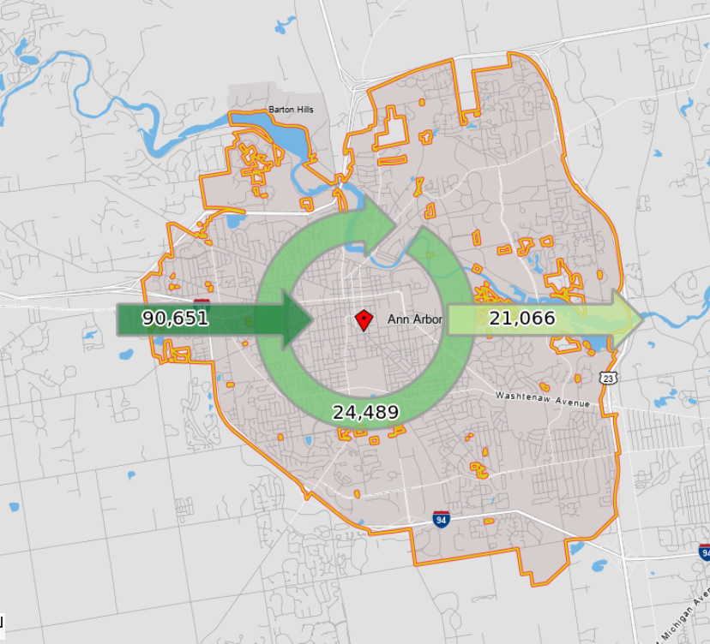
Commuting Patterns 90,651 commute in for jobs 24,489 live and work in Ann Arbor 21,066 commute out for jobs
Source: On the Map 2019
Notes:
2017 On the Map

Slide 27
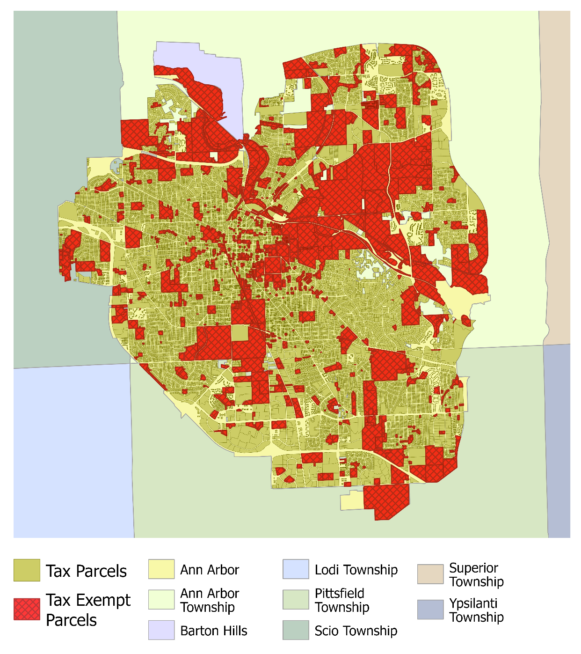
Only 60% of the City pays Property Taxes – 40% is Tax Exempt …
Category | Taxable Portion of Total
Residential | 39.4%
Commercial | 17.9%
Industrial | 1.5%
Taxable Total | 58.8%
City | 16.1%
University | 11.9%
A2 Schools | 5.7%
Other Gov’t | 2.6%
Religious | 1.8%
All Other | 3.1%
Non-Taxable Total | 41.2%
Source: City of Ann Arbor

Slide 28
Notes:
Downtown HNA

Slide 29
If there is such a huge demand for affordable housing, why isn’t the private sector building it?
Requires Subsidy
Limited
Resource
Market Driven
High Risk
Competitive
Site Specific

Slide 30
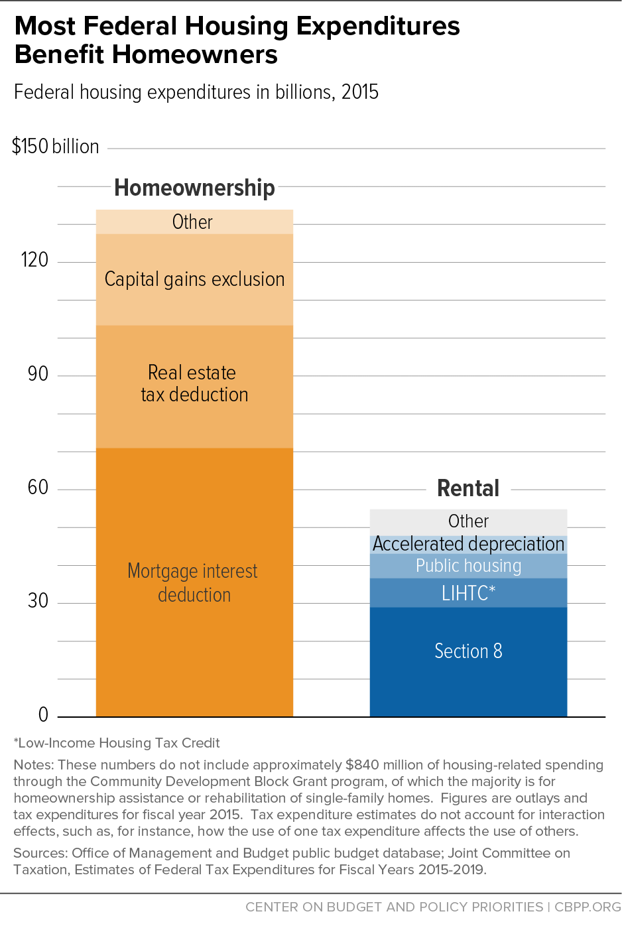
Federal Housing Programs
Housing & Urban Development (HUD) $47.9 Billion 2021
Public & Indian Housing ($28.4 Billion)
Project Based Section 8 & Housing Choice Vouchers ($18.8 Billion)
Homeless Assistance Grants ($2.8 Billion)
Internal Revenue Service (IRS)
Mortgage Interest Deduction $23.7 Billion 2021
Low Income Housing Tax Credits $10.4 Billion 2021 (average $9 Billion/yr)
Notes:
HUD data – from the President’s Budget request 2020
IRS data – from the Joint Committee on Taxation (JCT)’s estimates of foregone revenues

Slide 31
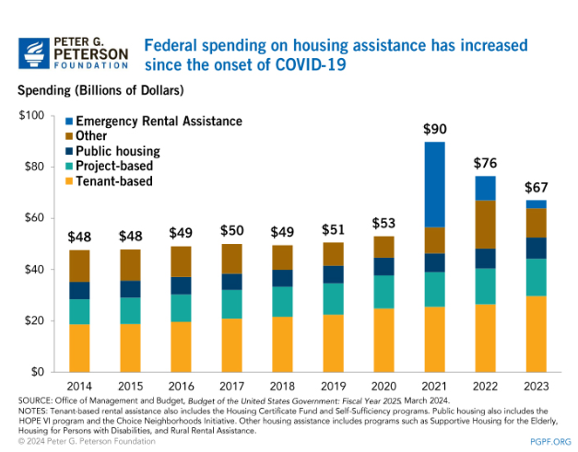

Slide 32
Housing Development Costs are the Same for Market Rate & Affordable

Slide 33
Typical Development Financing is Different Market Rate vs. LIHTC Affordable Housing
The biggest difference between market-rate development and affordable housing development is how it is financed
Market Rate
LIHTC 60% AMI Average
LIHTC (Non-profit developer)
30% AMI, 50% AMI & 60% AMI

Slide 34
Operating Revenue & Expense Market Rate vs. Affordable
ROI = Return on Investment

Slide 35
DEVELOPMENT/CAPITAL IMPROVEMENTS
FUNDING SOURCES BETWEEN 2013 – 2021
Low Income Housing Tax Credits (LIHTC) Equity |  | $44,104,698
Loans (Financial Institutions) |  | $11,523,100
City Funds (Ann Arbor Housing Fund, General Fund, Sustainability) |  | $4,388,765
AAHC (Capital Reserves & Other Smaller Grants) |  | $3,105,996
Federal Home Loan Bank (FHLB) |  | $2,670,000
DDA Grants |  | $2,440,330
HUD Grants |  | $1,905,483
Community Development Block Grant (CDBG) |  | $1,628,669
Insurance Proceeds |  | $807,278
Washtenaw County Brownfield Redevelopment Authority (WCBRA) |  | $615,000
TOTAL |  | $73,189,319

Slide 36
Ann Arbor Housing Commission
(STRATEGIC OBJECTIVES)
OBJECTIVE | PERFORMANCE MEASURE
Housing is available for all levels of income, especially for supportive affordable housing | By 2026 add 980 units of new affordable housing (60% AMI or under) in Ann Arbor. By 2024, develop a plan to ensure long-term funding for tenant social services.

Slide 37
Financial Feasibility Analysis of
City-Owned Sites
Downtown Sites
Outside Downtown
721 N Main
415 W Washington
404-406 N Ashley
350 S. Fifth parking lot (former Y)
S. Ashley/William parking lot
216 W William parking lot
121 E. Catherine parking lot
353 S Main parking lot
2000 S. Industrial
1510 E Stadium
Platt & Springbrook
1320 Baldwin

Slide 38
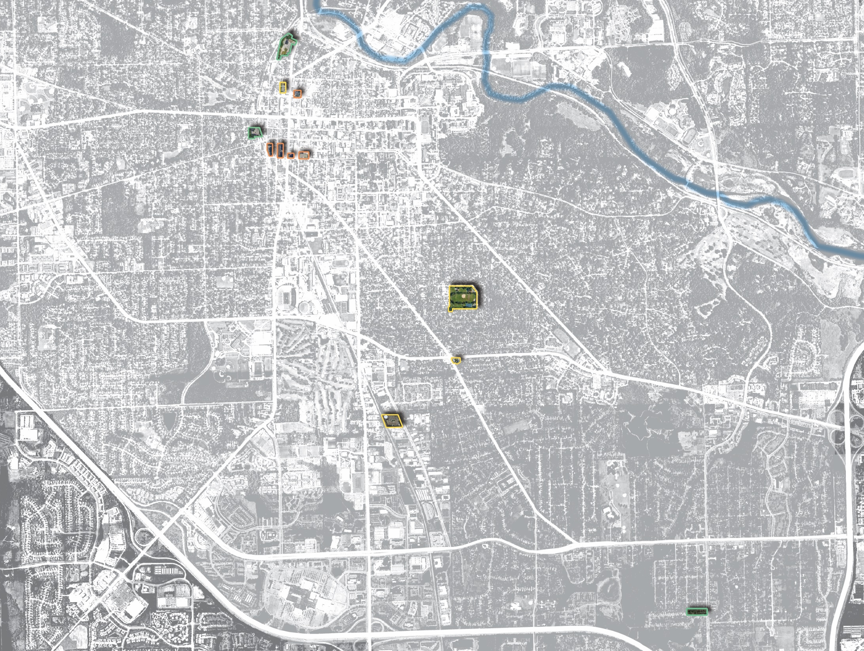
Potential HOUSING SITES
721 N Main
404 – 406 N Ashley
121 Catherine
Huron Ave
Building / Facilities
350 S Fifth Ave
415 W. Washington
216 W. William
353 S. Main
Washtenaw Ave
Surface Parking Lots
1320 Baldwin Ave
Stadium Blvd
104 -120 W. William
Vacant Properties
State St
Main St
Stadium Blvd
1510 E. Stadium
Ann Arbor Saline Rd
2000 S. Industrial
Packard St
US 23
Packard St
3432 - 3440 Platt & 3435 – 3443 Springbrook
I-94
Eisenhower Pkwy

Slide 39
Land Use
Restriction
City Adopted Planning Documents or Council Resolutions
Greenways & Treeline Trail
Zoning
Density & Height
Parking & Open Space
Deeds or Covenants
FEMA (Federal Emergency Management Agency)
MDEQ (Michigan Dept. of Environmental Quality)
* Park Property
Plans
Zoning
Legal
* Park property requires ballot approval to convert to another use
www.a2gov.org

Slide 40
Environmental
Conditions
Floodway/Floodplain
Noise
* Railroad within 300 feet of building
Underground Storage Tanks
Existing Buildings
Asbestos Containing Materials
Lead-based Paint
Brownfield Eligibility
Local
State
Federal
* Difficult to use federal or MSHDA funds to build affordable housing within 300 feet of railroads

Slide 41
Financial
Modeling
Financial Resources
Building Characteristics
Mixed Use
Amenities
Tenant Characteristics
Income Targets
Number of Bedrooms & Unit Square Footage
Construction Costs
Financing Costs
Loan Terms
Operating Cost Assumptions
* Low Income Housing Tax Credits (LIHTC)
Federal Housing and Urban Development (HUD)
Michigan State Housing Development Authority (MSHDA)
Ann Arbor Housing Fund (AAHF)
DDA Affordable Housing Fund
Brownfield Funding
Housing Revenue Bonds
Loans from Financial Institutions
Millage
Philanthropic Entities
Equity
Debt
Grants
Local
State
Federal
* LIHTC is by far the single largest source of funding for affordable housing in the United States for new developments
www.a2gov.org

Slide 42
Other Considerations
Ownership Structure
Homeowner, Rental, Cooperative
For-profit, Non-profit
Single Owner, Condo with Multiple Legal Entities
Market Demand
City Disposition Process
Lease, Sell

Slide 43
Conducted survey of AAHC residents & people at Bryant Community Center
105 responses related to living downtown, parking, families, apartment features

Slide 44
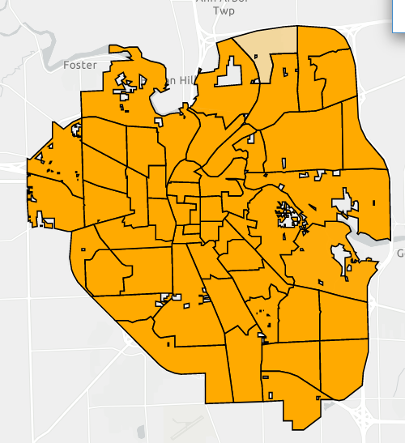
November 3, 2020 Proposal C Millage Results
Thank you “Partners for Affordable Housing”
73% approval
Every precinct voted in favor
51% - 88% of voters

Slide 45
BALLOT LANGUAGE
Shall the Charter be amended to authorize a new tax up to 1.000 mills for construction, maintenance, and acquisition of new affordable housing units for low-income individuals and families making less than 60% Ann Arbor Area Median Income, and for providing social services for the residents of such housing for 2021 through 2041, which will raise in the first year of levy the estimated revenue of $6,550,505.

Slide 46
CHARTER LANGUAGE
SECTION 8.25. In addition to any other amount which the City is authorized to raise by general tax upon real and personal property by this Charter or any other provision of law, the City shall, in 2021 through 2041, annually levy a tax of up to one mill on all taxable real and personal property situated within the City for the purpose of building, maintaining, and acquiring new affordable housing units which are permanently affordable to low-income households making no income up to 60% of area median income and providing social services, not to exceed 20% of the millage revenues over the entire term of the millage, for the residents of such housing. No money collected pursuant to this millage shall be spent on building, maintaining, or acquiring new units located in the floodplain or floodway.

Slide 47
Guidelines Adopted by City Council July 27, 2020
Socio-Economic Diversity
All Neighborhoods
100% Affordable
Mixed-Income
Group Homes
Apartment Complexes
Resident Services
Mental Health
Physical Health
Financial Services
Job Skills & Employment
Daily Living Skills
Crisis Management
Conflict Resolution
Youth Programming
Inclusive & Equitable
Special Needs
Seniors
Persons with a Disability
Youth Aging out of Foster Care
Homeless

Slide 48
Guidelines Adopted by City Council
Leverage
Maximize
Other Resources
Philanthropic
Public
Private
Development
New Construction
Acquisition
Demolition
Infrastructure
Utilities
Renovations
Sustainability
Energy Efficient
Green Construction
Net Zero
Permanent Affordability
Publicly-Owned Properties
Ann Arbor Housing Commission
Mission Driven Non-Profits
Cooperatives
Owner Models with
Permanent Affordability

Slide 49
Affordable Housing Millage Strategy
Develop budget that includes AAHC projects in pipeline, including city-owned properties
Build in flexibility for properties unexpectedly on the market
Develop application process with HHSAB for non-AAHC projects
Based on City Council adopted millage guidelines
Ensure investment in feasible projects with qualified developers
Capital Funds/Resident Services Funds
Capital funds drawn down first and one time
Services funds drawn down second and will require annual budget approval
Need to track ongoing annual service requests tied to capital projects

Slide 50
Affordable Housing Millage Avalon Development & Tenant Services Projects
Hickory Way
3 Phases – 84 units
34 units Phase I - Completed
36 units Phase II – Completed
14 units Phase III – Design Phase
All 1 bedroom
Mixed Income
30% AMI & reserved for households who are homeless or special needs
50% AMI
60% AMI
$27M Total Development Costs
$550,000 City millage capital
$182,000 FY23 services
Notes:
Moving in HH, permanent CofO on hold due to bio-retention pond. Working on with contractor and city
Phase I & II
30% AMI = 35/70
50% AMI = 8/70
60% AMI = 27/70

Slide 51
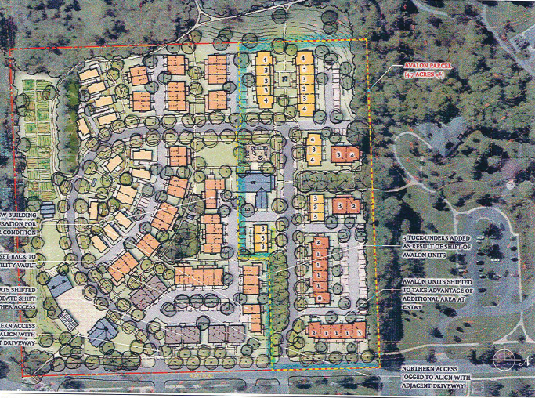
Avalon Project
The Grove at Veridian
50 affordable apartments
1 to 4 Bedrooms
30 units up to 30% AMI & reserved for households who are homeless or special needs
20 units up to 60% AMI
$20.6 Million Total Development Costs
$1.9 million city millage capital
$300,000/year services

Slide 53
Cross section of participants
Stakeholder meetings
Workshops
Website
On-line survey
Public meetings
Direct mailings
Social media
Range of Ages
Range of Incomes
85% Ann Arbor residents
All 5 wards represented
90% self-reported moderate to good understanding of affordable housing
Except over-represented white race & homeowners

Slide 54
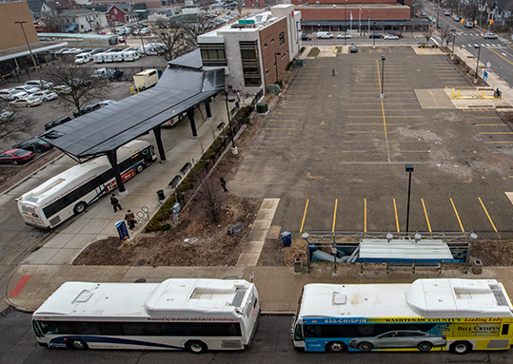
AAHC Projects
350 S 5th
4.4.2022: City Council approved PUD & Supplemental Regs
Next Step: Site Plan Approval then RFP for Development Partner
2 Phases/Towers
~95 units, West, 17 stories
~201 units, East, 18 stories
1Bdr & 2Bdr
Mixed Income
Minimum of 100 units and minimum of 40% of total residential units affordable up to 60% AMI
Set-aside for 30% AMI households who are homeless and/or special needs
Fully electric (except back-up generator)
Will meet NetZero 2030 goals
Notes:
18 stories
900% FAR
134 Class A bike spaces, 34 Class B
No parking

Slide 55
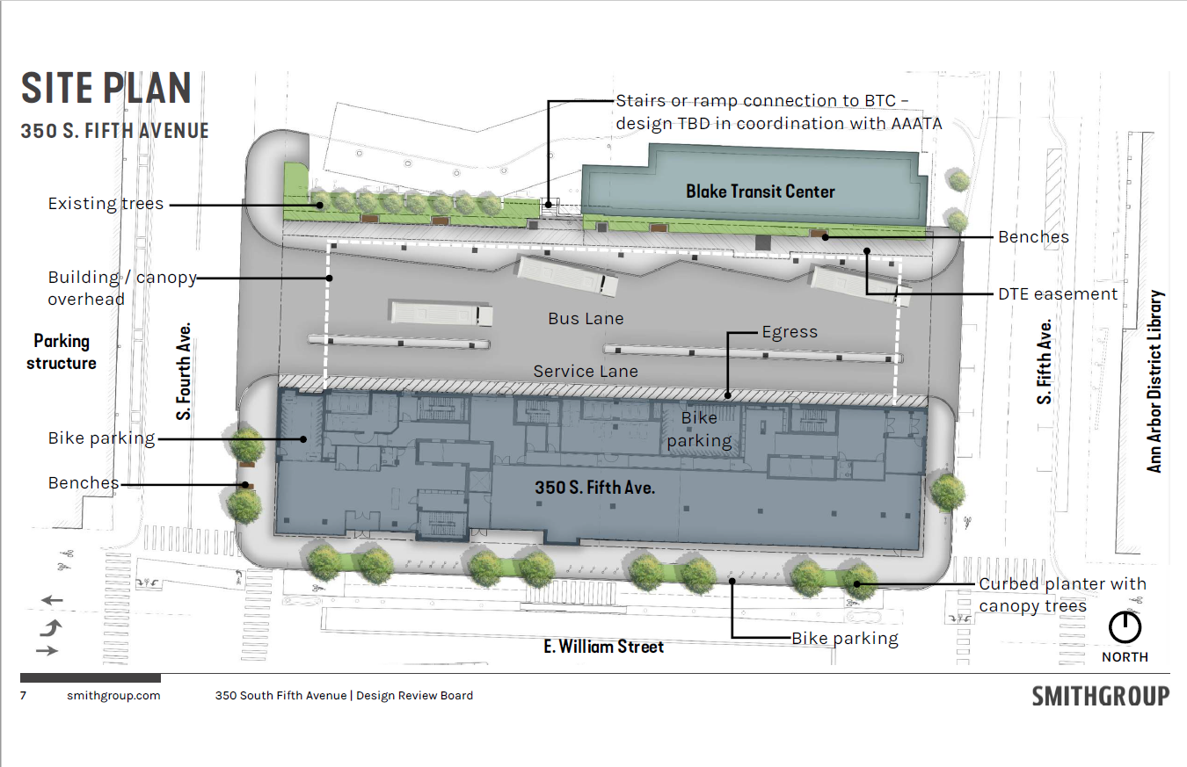

Slide 56
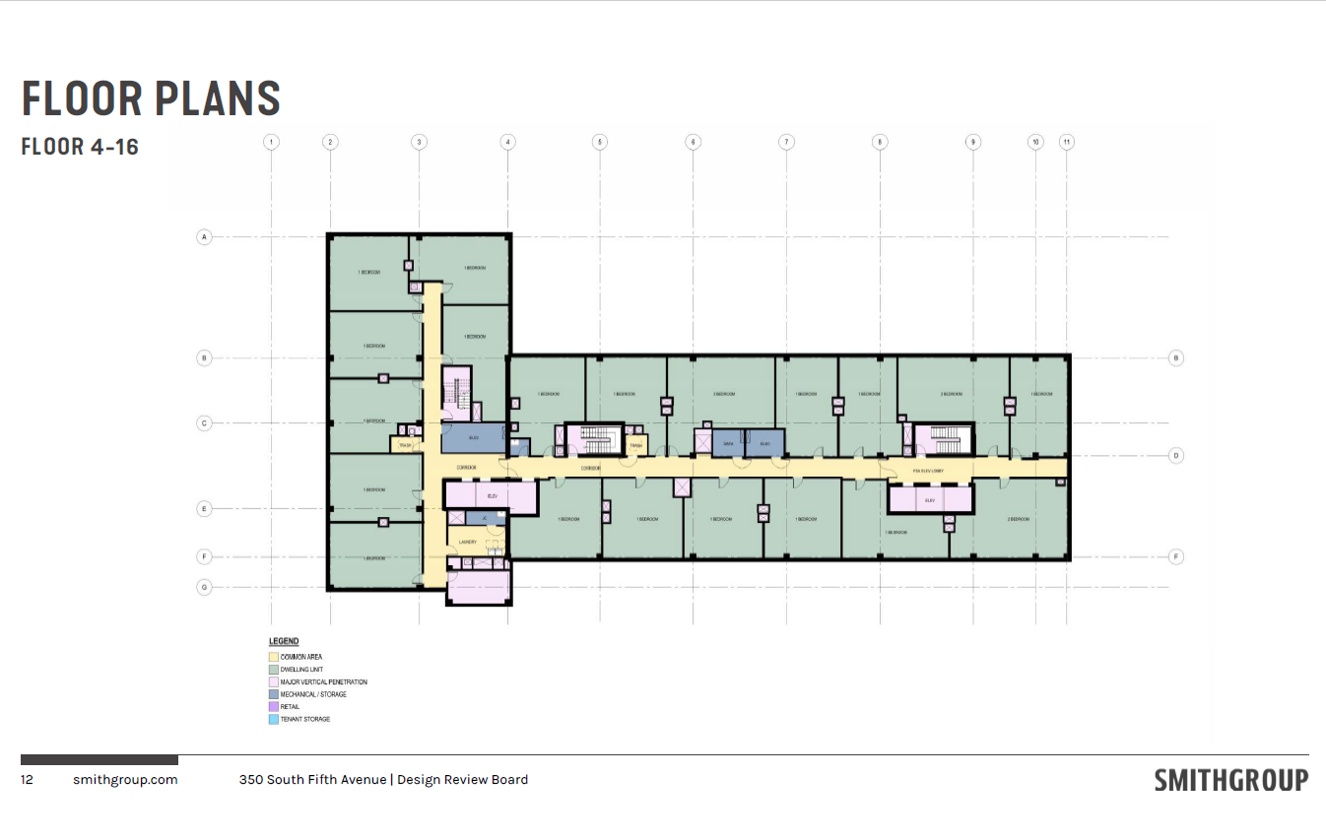

Slide 57
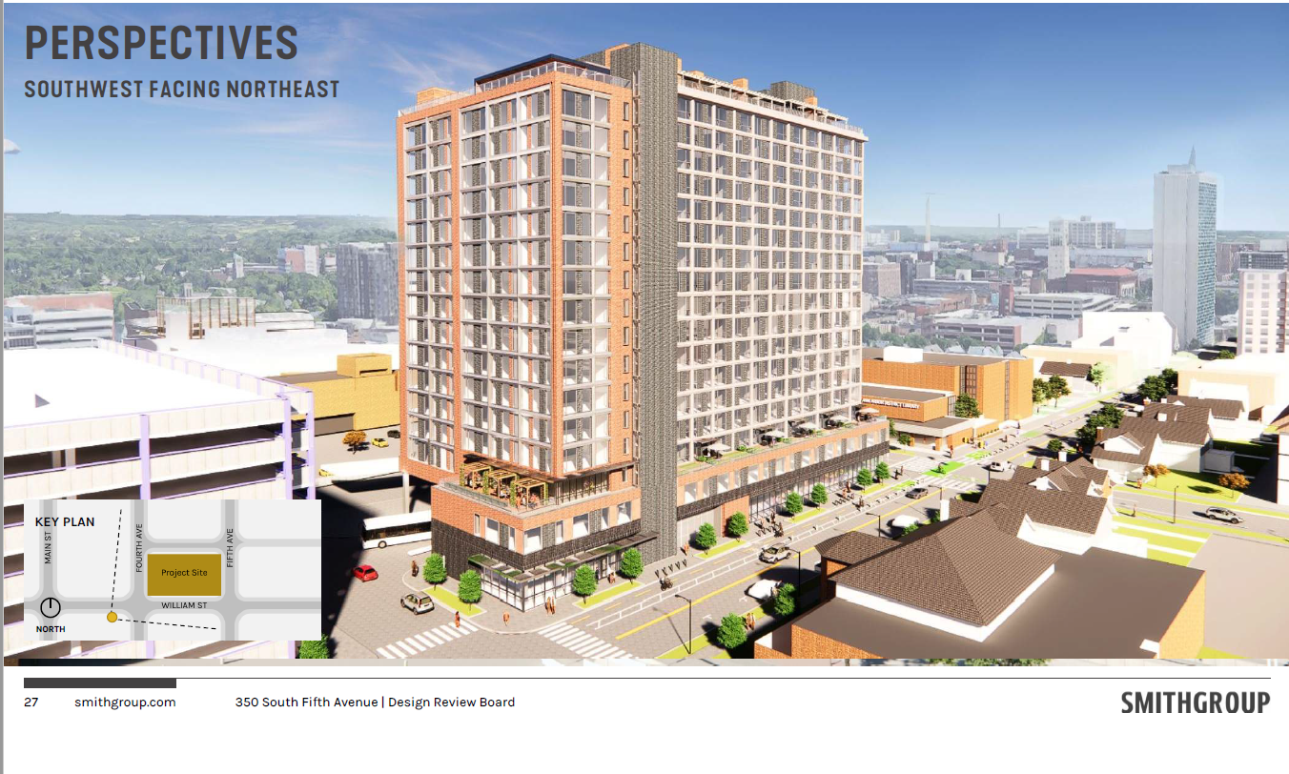

Slide 58
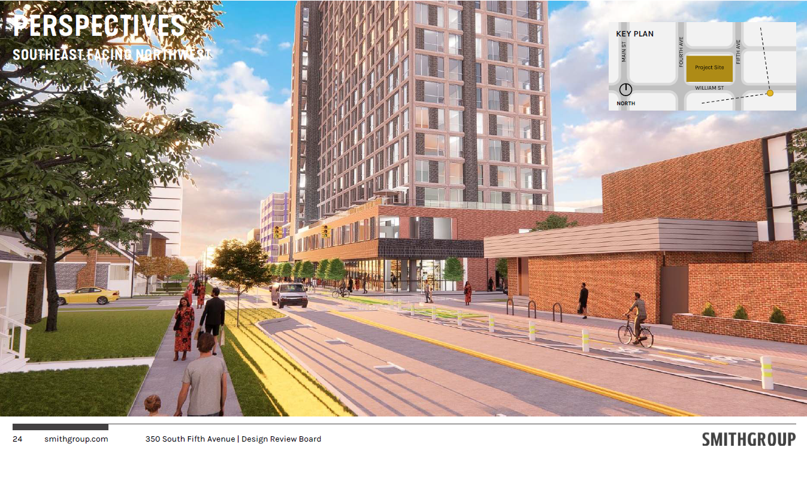

Slide 59
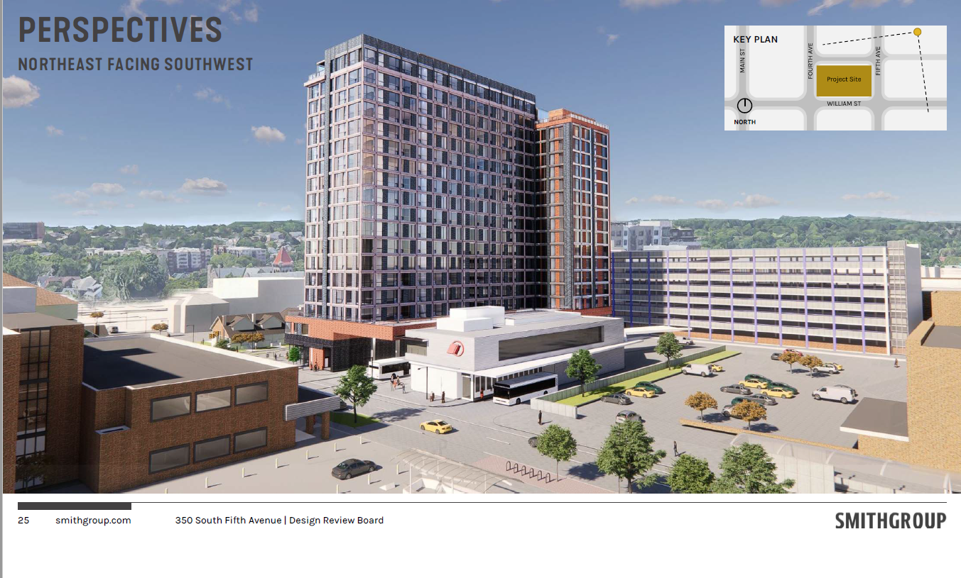

Slide 60
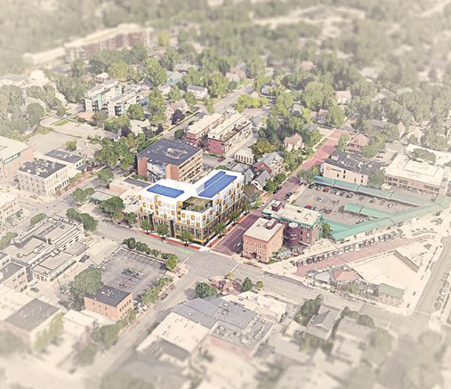
121 E Catherine
63 units
62 1-bedroom
1 2-bedroom
6 stories
100% Affordable
up to 60% AMI
Supportive Housing and people in the arts
Preserve as much parking as possible
14 public spaces
2 EV tenant shared vehicles
1st floor BIPOC Cultural, Community and/or Maker’s Space (business support)
Notes:
Zoning D2 (medium density)
Character overly district – Kerrytown
Lot 16,368 SF
FAR 200% or 400% if planned affordable project with housing premium
Mx Height 60 feet or 69 feet with affordable housing premium
Streetwall – 2 stories minimum and 3 stories max.

Slide 61
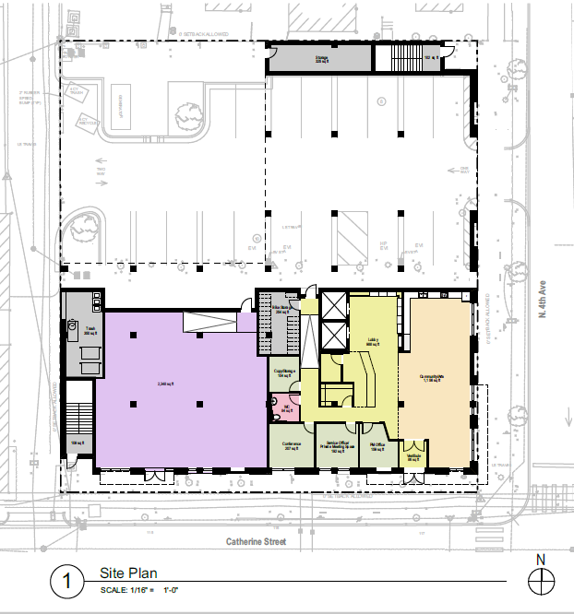
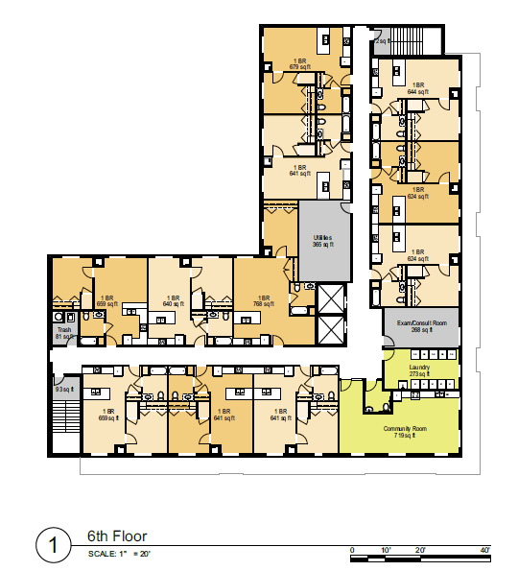

Slide 62
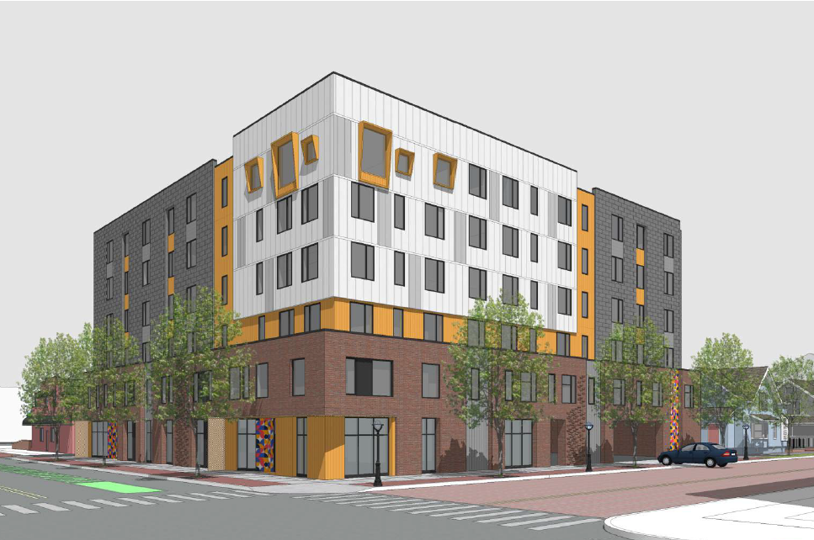
121 Catherine
Funding Sources
Total Development Sources | $31,264,753
LIHTC Equity | $13,198,680
Perm Loan (Chelsea State Bank) | $2,000,000
Washtenaw County HOME | $763,112
MEDC RAP Grant | $5,000,000
DDA Funds | $650,000
City Housing Millage | $6,893,288
WCBRA Brownfield Funding | $959,406
EGLE Funds | $1,000,000
Federal Home Loan Bank | $600,000
45L Tax Credit funding | $133,875
Deferred Developer Fee | $66,392
Notes:
Millage enormous benefit, but unable to keep up with the skyrocketing costs of construction – labor and materials. Even with the millage, we have 11 sources of funding plus our construction loan. Its getting harder and harder to fill the funding gap the lower the income target the development is.

Slide 64
415 W Washington
Floodway/Floodplain
Must Elevate Residential Use
Adjacent to Railroad
NOT LIHTC Eligible
NOT HUD or MSHDA Funding Eligible
NOT Affordable Housing Millage Eligible
Brownfield TIF Eligible
15% units affordable to 60% AMI
DDA Funding Eligible
Chimney Swift Disturbance
Coordinate with Greenway
High Local Subsidy Per Unit if all affordable
Can sell & use proceeds for affordable hsg
Notes:
ON-LINE RESPONSE – OBJECTIVES
Remediate any potential environmental contaminations
Connect to the Treeline Trail
Maximize affordable housing units for 60% AMI households on site
Preserve Chimney Swift Habitat
Provide additional uses (e.g. maker space, production space, office space, commercial space)
Sell the property and use proceeds for affordable housing on another city-owned property
Fit in with existing adjacent building heights and scales
Maximize park space
Fit in with existing setbacks along Washington Street
Provide adequate buffer to adjacent single family housing
Maximize market rate residential

Slide 67
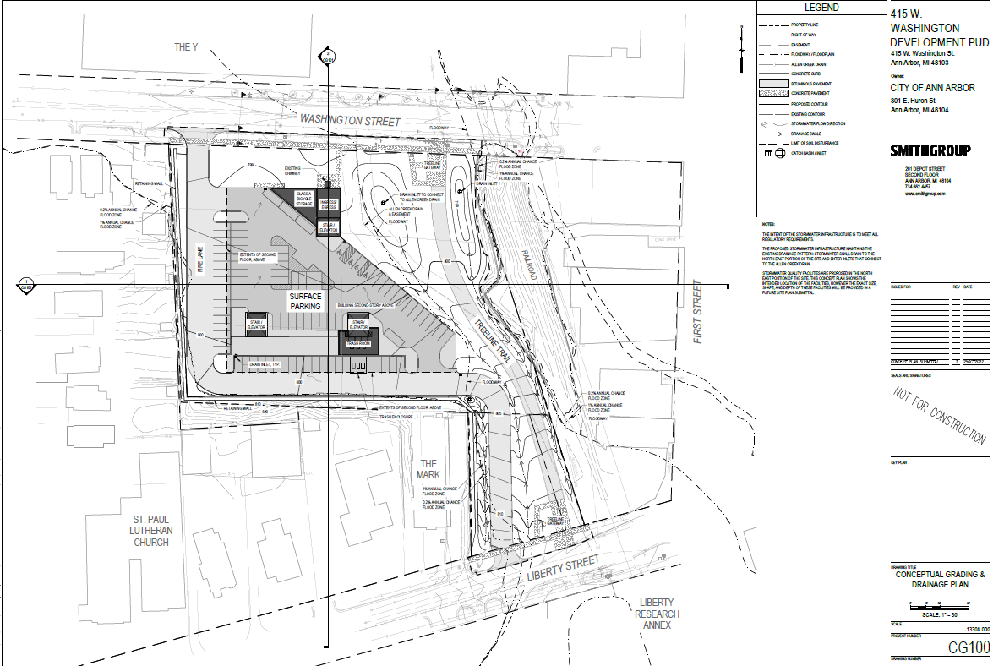

Slide 68
404 - 406 N Ashley
No Negative Site Issues
LIHTC Eligible
High Scoring
Perfect Size to Max Out Funding
60 - 85 units
HUD and MSHDA Funding Eligible
DDA and Millage Funding Eligible
Minimal Local Resources Needed
UM Dental Clinic Lease Expires 12/2024
c
Recommend AAHC as Developer with Ground Lease: Can Begin Design and Site Plan Approval Process 2024

Slide 69
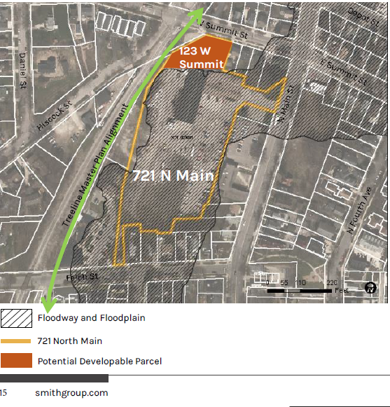
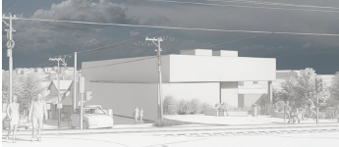
721 N Main/123 W Summit
5 -12 apartments
Townshomes or 2 – 3 story stacked flats
All affordable to households up to 60% AMI
Next Steps
Lot Split
Site plan approval process
Notes:
Difference between this site and W Washington. In addition to floodway/floodplain, EPA grant that demolished a building and EPA restricts redevelopment of any buildings from being developed in the floodway or floodplain

Slide 70
415 W Washington
Floodway/Floodplain
Must Elevate Residential Use
Adjacent to Railroad
NOT LIHTC Eligible
NOT HUD or MSHDA Funding Eligible
NOT Affordable Housing Millage Eligible
Brownfield TIF Eligible
15% units affordable to 60% AMI
DDA Funding Eligible
Chimney Swift Disturbance
Coordinate with Greenway
High Local Subsidy Per Unit if all affordable
Can sell & use proceeds for affordable hsg
Notes:
ON-LINE RESPONSE – OBJECTIVES
Remediate any potential environmental contaminations
Connect to the Treeline Trail
Maximize affordable housing units for 60% AMI households on site
Preserve Chimney Swift Habitat
Provide additional uses (e.g. maker space, production space, office space, commercial space)
Sell the property and use proceeds for affordable housing on another city-owned property
Fit in with existing adjacent building heights and scales
Maximize park space
Fit in with existing setbacks along Washington Street
Provide adequate buffer to adjacent single family housing
Maximize market rate residential

Slide 74
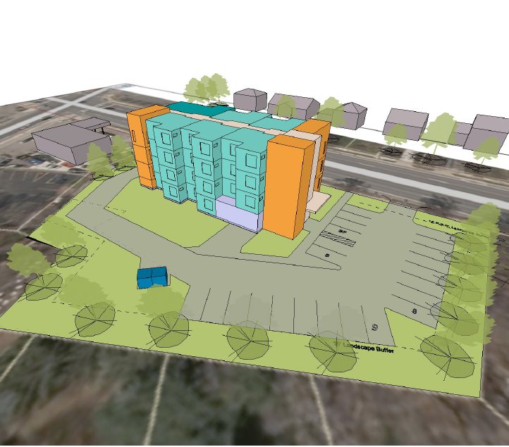
1510 E Stadium
No Site Issues
LIHTC Eligible
Scores Poorly Based on Location
Small for Stand-Alone LIHTC
8 - 23 Units
HUD & MSHDA Funding Eligible
Millage Funding Eligible
Demolition of Fire Station
Or Potential AAHC Office/Maintenance
Temporary or Permanent
High Local Subsidy Per Unit
c
c
c
Next Steps: Wait until Fire Station #2 staff can move to Fire Station #1, then redevelop
Notes:
Looked at townhomes and 3-4 story building as well as reuse of existing building. May need to temporarily relocated AAHC staff there while 2000 S. Industrial developed

Slide 75
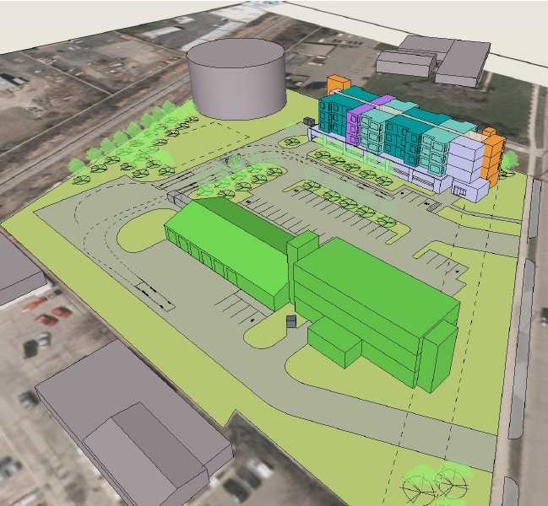
2000 S. Industrial
Underground Storage Tank
NOT LIHTC Eligible
NOT HUD & MSHDA Funding Eligible
Adjacent to Railroad
Large Site – High Potential
50 - 165 Units
Test Site for Revenue Bond Financing
Millage Funding Eligible
AAHC Office/Maintenance Relocation
High Local Subsidy Per Unit
c
c
Next Steps: Need a city-wide space needs assessment to determine what should be developed on site besides housing
Notes:
Currently gas tanks, bathrooms, electric vehicle charging stations, warehouses and AAHC office and maintenance facilities. Clerks office identified a need for additional storage and meeting space for election ballot counting as example.

Slide 77
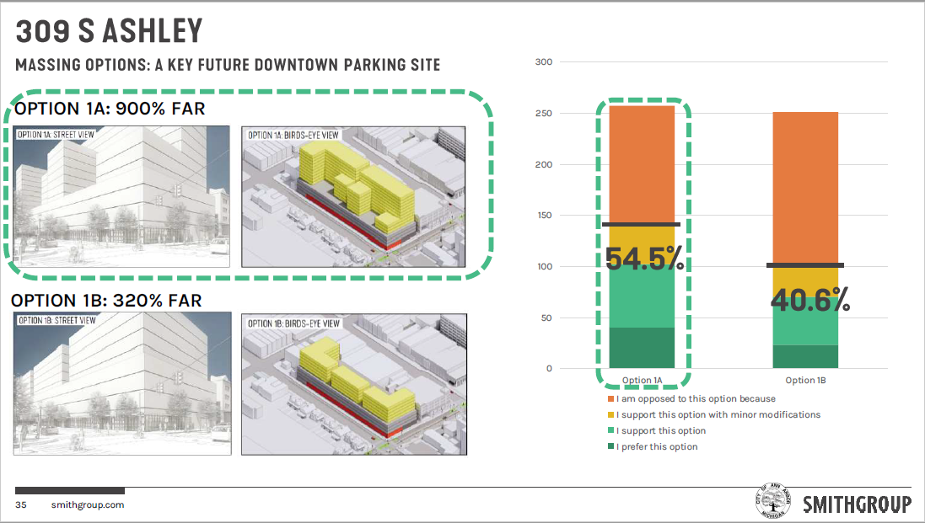

Slide 78
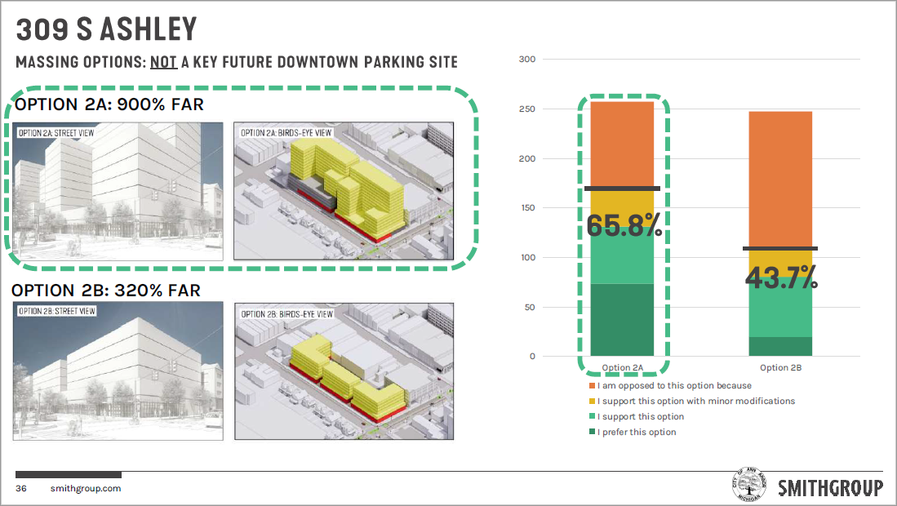

Slide 79
353 S Main
No Negative Site Issues
LIHTC Eligible
High Scoring
Perfect Size to Max Out Funding
50 - 90 units
HUD and MSHDA Funding Eligible
DDA Funding Eligible
Minimal Local Resources Needed
c
c
AAHC as Developer and moving to Site Plan Approval Process

Slide 81
Platt & Springbrook
No Site Issues
LIHTC Eligible
Scores Poorly Based on Location
Too Small for Stand-Alone LIHTC
12-14 Units
HUD & MSHDA Funding Eligible
Expensive Infrastructure Per Unit
Road
Water and Sewer
High Local Subsidy Per Unit
c
c
c
Next Steps: Community Engagement related to Density, Owner/Rental, single-family/multi-family

Slide 82
2022 AAHC NEW HUD DESIGNATION: LANDLORD INCENTIVES COHORT #4 MOVING TO WORK
Competitive Process
29 Public Housing Authorities Designated under Cohort #4
139 PHA’s total approved for MTW Designation
Benefits
Regulatory flexibility
Funding fungibility & flexibility
5-year Study
Increase landlord participation in voucher program
Increase lease-up success for participants

Slide 83
MTW Implementation
Tenants
Address barriers such as credit score or lack of credit
Security deposit assistance
Utility deposit assistance or utility arrears payments
Housing search assistance
Renter’s insurance
Initial move-in essential household items like beds, towels, kitchen supplies
On-line tenant portal: rent payments, income certifications, waitlist, communications

Slide 84
MTW Implementation
Landlord Recruitment & Retention
Pre-inspection of units
Incentives for new landlords
Incentives to retain landlords
Assist with repairs to apartments
Unpaid rent mitigation fund
Vacancy payments between tenants
Holding fees
On-line landlord portal: payments, inspection status, communications

Slide 85
Housing & Human Services Educational Series

Slide 86
Group Question
Talk about something you have learned so far today that you did not previously know

